Slide 1
Lab 1

Slide 2
The plan
Getting you up to speed with R
R and Rstudio check-up
Interactive intro to R via Swirl
Getting you up to speed with the exercise format
R MarkDown
Exercise!

Slide 3
Checking up R and Rstudio
Do you all have it?
Does it work?

Slide 4
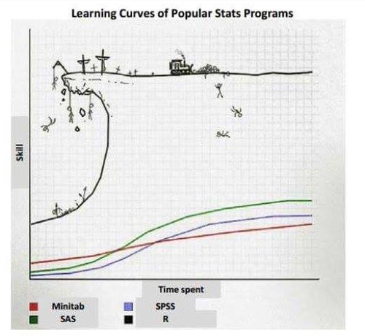
R and other statistical programs

Slide 5
Be on that bulldozer!
R is a programming language developed for doing statistics
Free and open source!
Scriptable (reproducible and reusable)
Googlable (much much help online)
New methods developed ALL the time!
All analyses with 1 line of code!
Truly!
Though the data pre-processing is much longer…

Slide 6
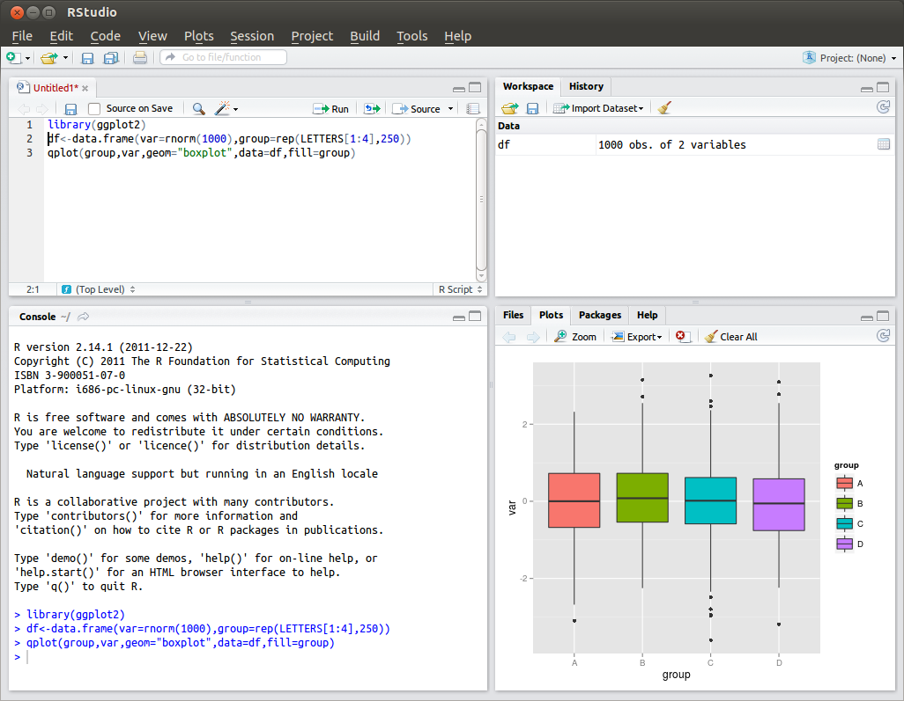
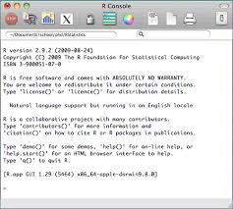
Rstudio: a nice interface to keep it all in place (data, code, output, plots)

Slide 7
Ready to start?

Slide 8
Intro to R via Swirl
Let’s do a quick intro to R programming:
Open RStudio
install.packages("swirl")
library(swirl)
install_from_swirl(”R Programming Alt")
swirl()
Questions?
NB: More advanced users can try
install_from_swirl(”Open Intro”)

Slide 9
How was that?

Slide 10
Key concepts
Variable
Datasets
Vector
Matrix
Operations

Slide 11
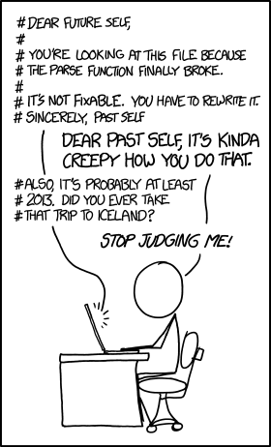
Let’s move to the next level!

Slide 12
Real example I
Running the same analysis many times
Predicting autism from voice
Predicting schizophrenia from voice
Predicting depression from voice
Predicting bipolar disorder from voice
….
Silly younger me runs the analysis from scratch every single time!

Slide 13
Real example II
Finding a mistake in the data
Spend a few days understanding how to run a complicated analysis (predicting social relationships from laughs)
Send a happy mail to collaborators: “Look at what I found!”
2 weeks later get a response: “Sorry, we mislabeled the data! Could you re-run it on the new corrected data?”

Slide 14
Real example III
Understanding your code
Write a script analysing the laughter data in 2013 and send the results to co-authors
Get an email in 2015: “Could you write a paragraph for the paper explaining exactly what you have done?”
Desperation follows (I had to write a new script to understand what I had done and kept getting different results).

Slide 15
Lessons learned
Always write your code as a script
Re-usable and modifiable
Always carefully document your code
Comments, comments, comments
R Markdown

Slide 16
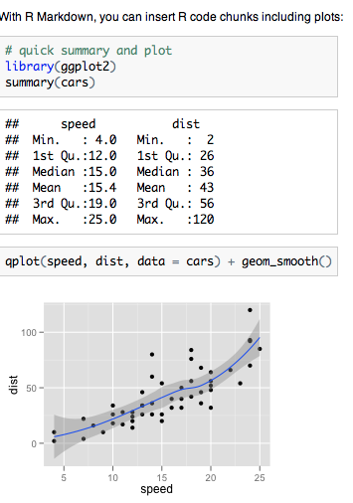

R MarkDown

Slide 17
LET’S HAVE A LOOK

Slide 18
Check the Day1Exercise1 Rmd file
It solves the first steps of Josh’s exercise
White background is text
Grey background is code
To see what the code does:
One line at a time: position your cursor on the line, push “Run”
The full document: push Knit html

Slide 19
Structure of the exercises
Instructions in the white part, to be solved in the grey part
Push on knit and you have a ready fancy report!

Slide 20
A cheat sheet for R Markdown
http://shiny.rstudio.com/images/rm-cheatsheet.pdf.zip

